Slide 1
ROKYCANY FLOOD PROTECTION
Course: Spatial Planning in Flood Protection

Slide 2
Table of Content
Area Overview and Current Situation
Flood protection measures
MCDM-analysis

Slide 3
Area Overview and Current Situation

Slide 4
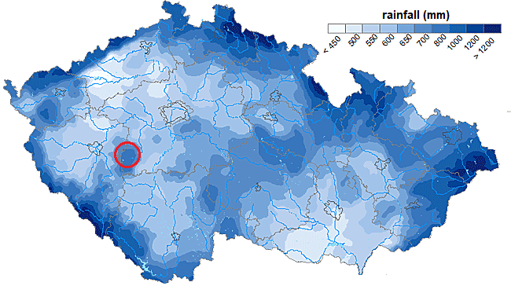
Location and Hydrology
Fig. 1

Slide 5
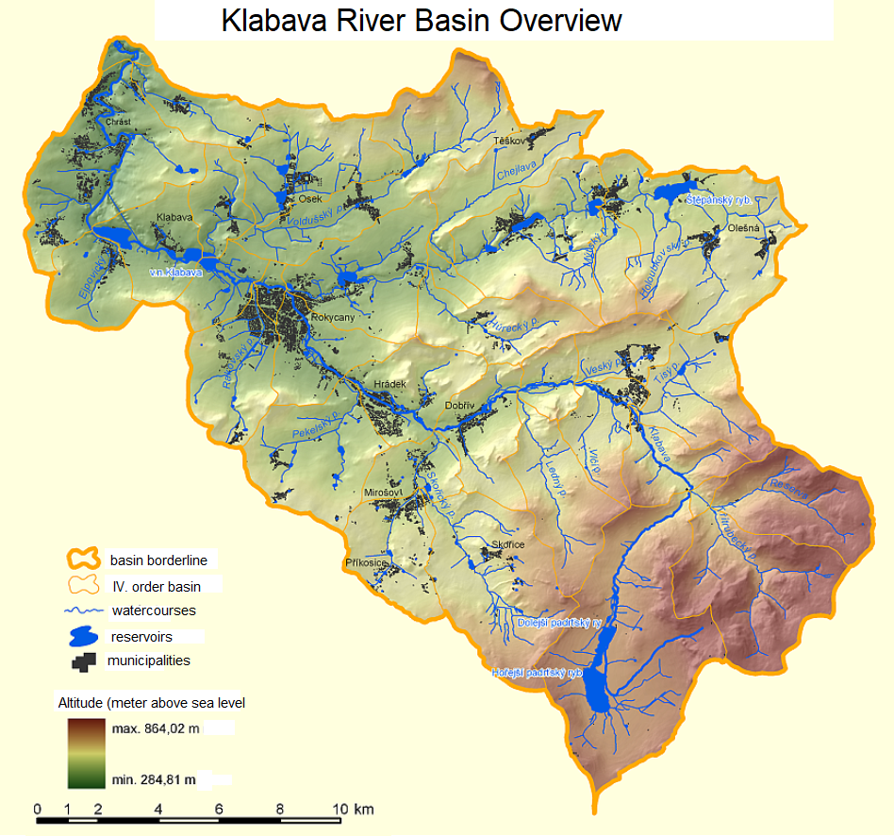
Klabava River Basin Overview
Fig. 2

Slide 6
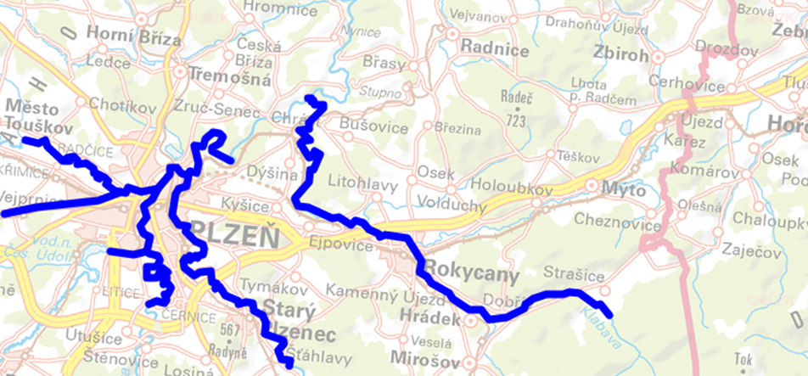
Situation at the beginning of Rokycany
Fig. 3

Slide 7
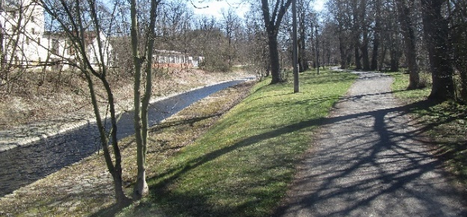
Situation at the beginning of Rokycany
Fig. 4

Slide 8
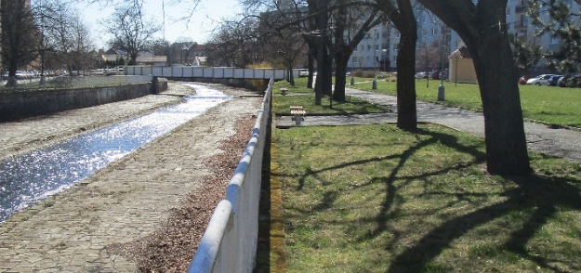
Situation in Rokycany
Fig. 5

Slide 9
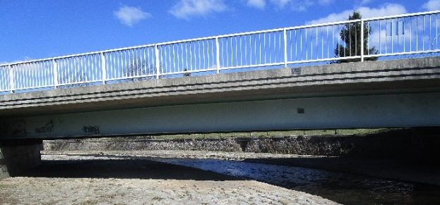
Situation in Rokycany
Fig. 6

Slide 10
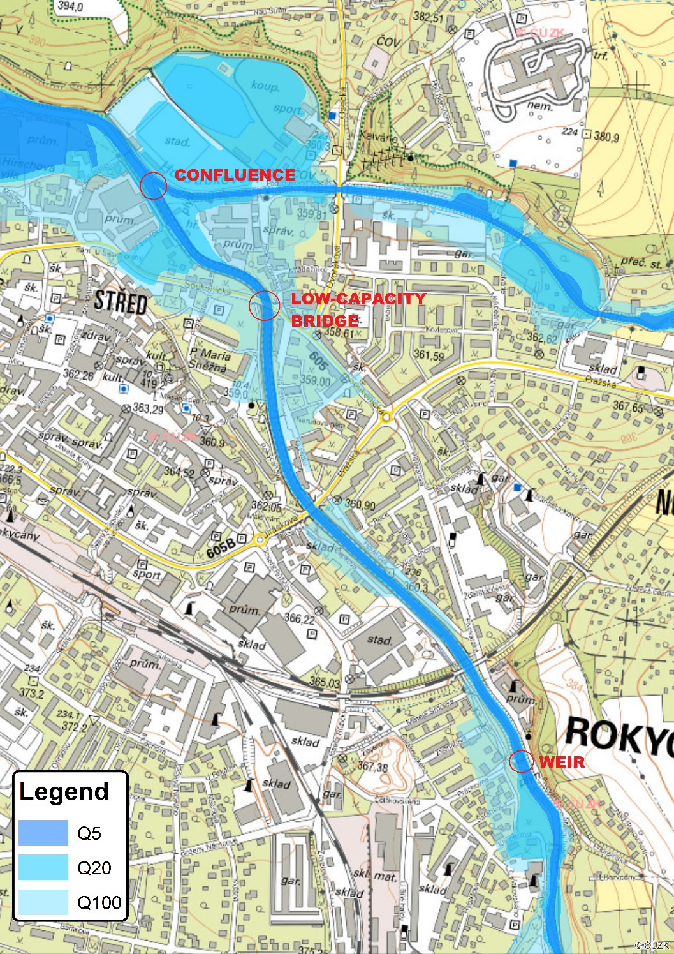
Flood prone areas in Rokycany
Fig. 7

Slide 11
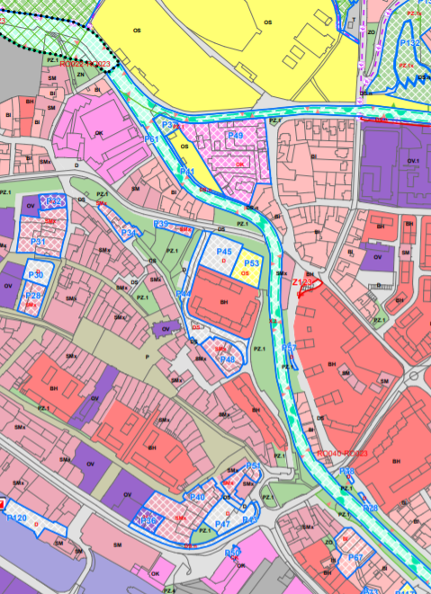
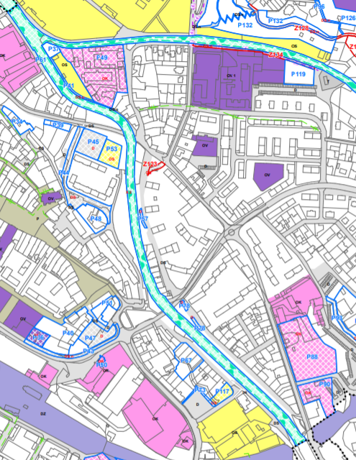
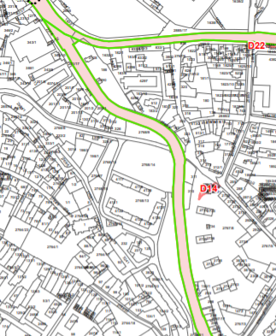
Spatial Plan of Rokycany
Fig. 8-10
Fig. 7

Slide 12
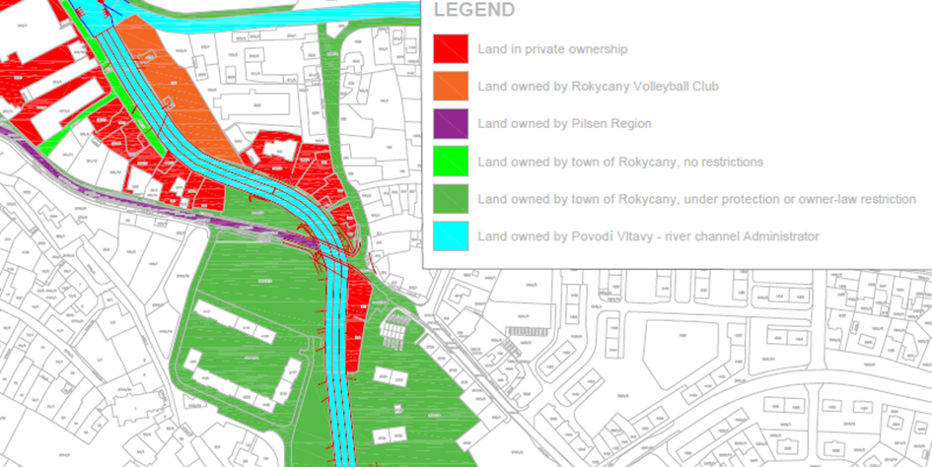
Land Ownership in Rokycany
Fig. 11

Slide 13
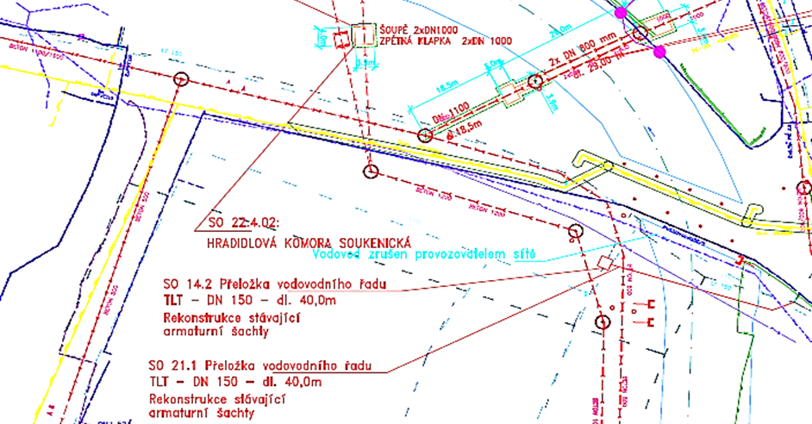
Public Utility Network
Fig. 12

Slide 14
Flood Protection measures

Slide 15
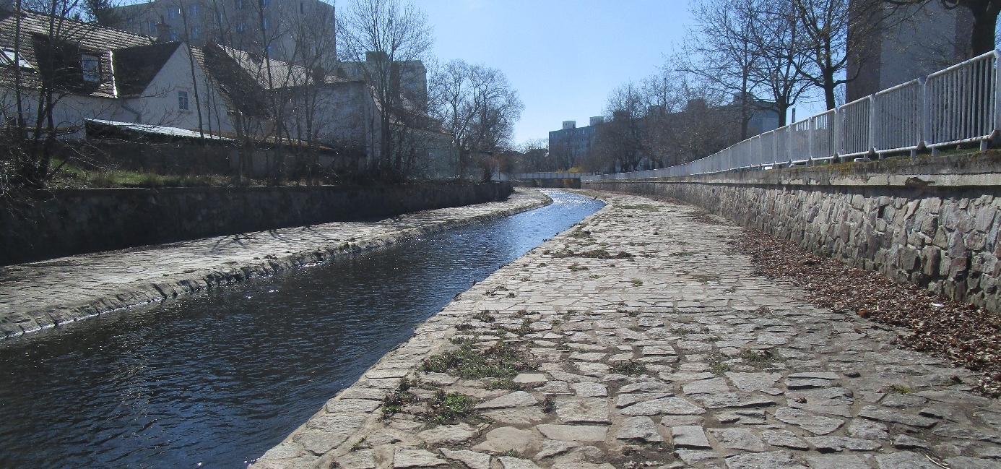
Current Flood protection
Fig. 13

Slide 16
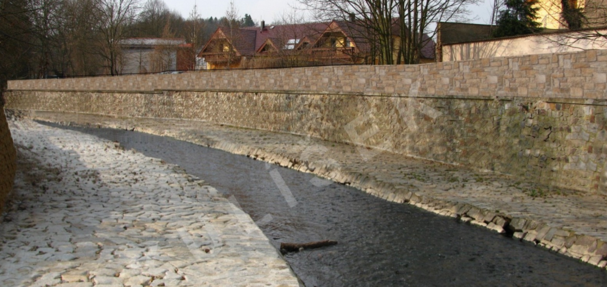
Strengthening of current flood protection
Fig. 14

Slide 17
SWOT analysis
Strengths
- hydraulically functional and efficient
- relatively simple and easy to implement
Weaknesses
- Controversial opinion in the society
Opportunities
- Fast and easy to implement
Threats
- Cutting off the river from the city

Slide 18
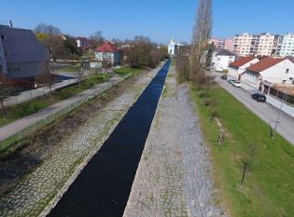
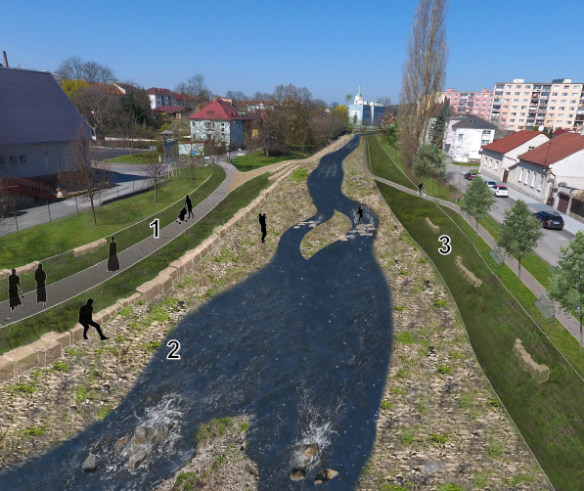
Nature based flood protection
Fig. 15

Slide 19
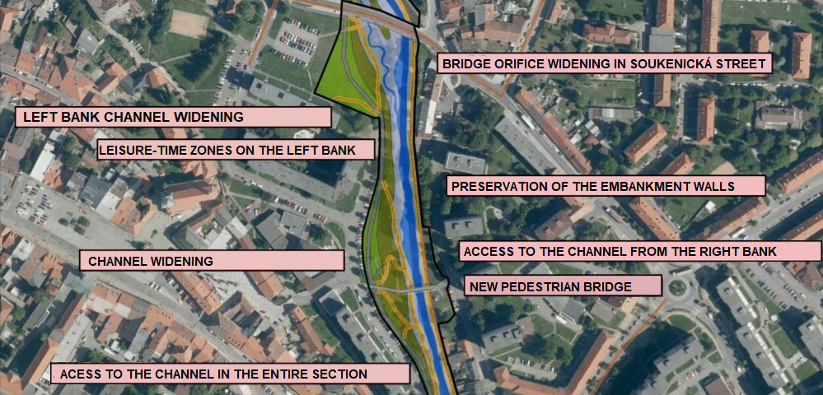
Nature-based Flood Protection
Fig. 16

Slide 20
SWOT analysis
Strengths
- widening of the channel possible
- Utilities near the river have to be renewed and therefore can also be relocated while reconstruction
Weaknesses
- Sewer line in immediate vicinity of both riverbanks
Opportunities
- Use of the river for recreation
- More nature-friendly riverbed
- More attractive space in the town
- Implementation of walking and cycling baths alongside the river
- Favoured by inhabitants
Threats
- High financial costs of nature based solutions

Slide 21
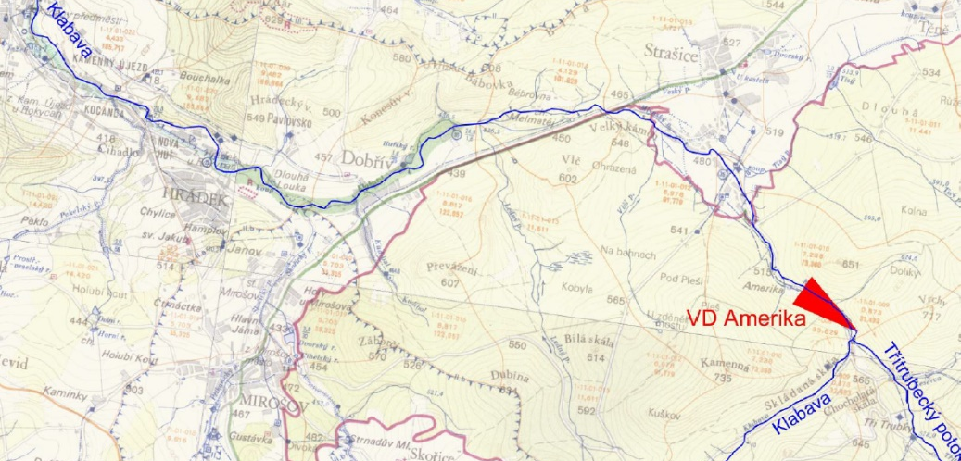
America Dry Retention Area
Fig. 17

Slide 22
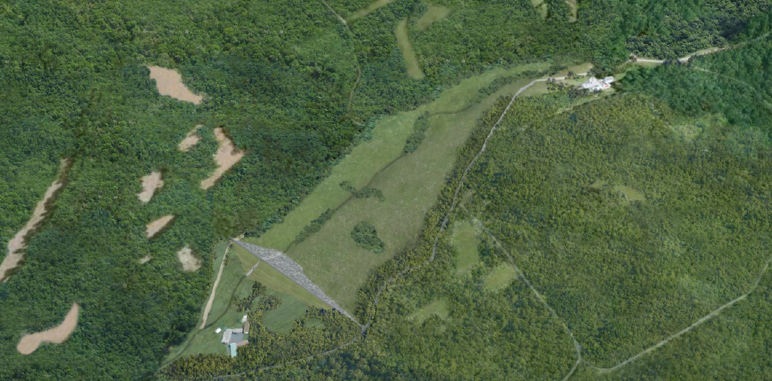
Amerika Dry Retention Area
Fig. 18

Slide 23
SWOT analysis
Strengths
- Reasonable from economic point of view
Weaknesses
- deforestation of 29 ha
Opportunities
- when in use, current flood protection measures sufficient
Threats
- Loss of a very valuable area both ecologically and landscape-wise

Slide 24
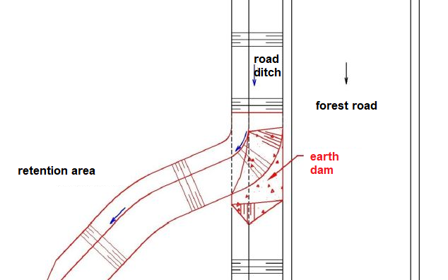
Brdy Retention Capacity Increase
Fig. 19

Slide 25
SWOT analysis
Strengths
- Higher amount of water retention in the Brdy area
Weaknesses
- decrease of economic benefit from the forest area
Opportunities
-Reduce of the runoff with 100 year return period by 25 %
Threats

Slide 26
MCDM-Analysis

Slide 27

MCDM analysis
Criteria for decision making :
the ability to retain flooding,
the costs,
the integration into the landscape,
the environmental impact.
Our notation:
0 : the solution does not meet the requirement
2 : the solution is the worst in this criteria
6 : the solution meets expectations
8 : the solution is the best in this criteria

Slide 28
MCDM analysis
💶 Budget scenario
🔗 Balance between costs and environment
🌿 Environmental scenario
Ability to retain flooding | Costs | Integration into the landscape | Environmental impact
0,4 | 0,3 | 0,15 | 0,15
Ability to retain flooding | Costs | Integration into the landscape | Environmental impact
0,3 | 0,3 | 0,15 | 0,3
Ability to retain flooding | Costs | Integration into the landscape | Environmental impact
0,4 | 0,15 | 0,15 | 0,3

Slide 29
MCDM analysis, ranking of the solutions

Slide 30
Thank you for your attention!

